Slide 1







Project – “Online_ Shopping_System 2” in mysql
- Presented BY “Nutan ZINE”

Slide 2


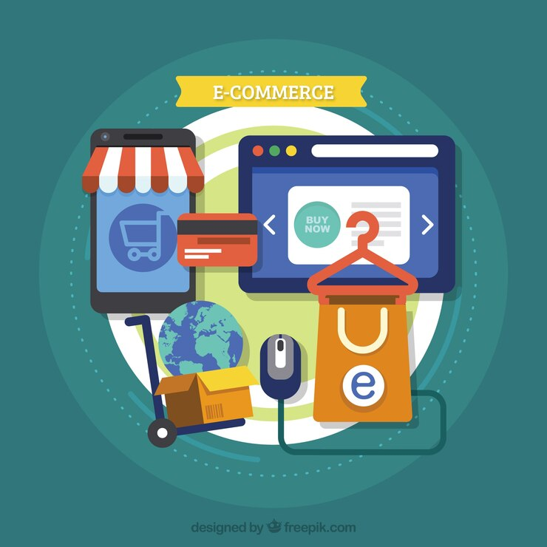
Introduction :
✅ Project Objective : Designed a relational database for an e-commerce platform to handle users, products, orders, and transactions efficiently.
🧩 ER Diagram & Schema Design : Created a detailed Entity-Relationship diagram and normalized tables to represent real-world shopping system entities and their relationships.
🔐 Database Concepts Used : Applied primary keys, foreign keys, indexing, and data integrity constraints.
🧮 SQL Operations : Implemented CRUD operations (Create, Read, Update, Delete) and complex SQL queries including joins, aggregate functions, subqueries, and views.
📦 Inventory & Order Management : Designed modules for managing product availability, order tracking, and payment records.
📊 Data Analysis & Reporting : Generated SQL-based reports for sales summaries, customer activity, and product popularity.
💻 Hands-on Tools : Worked with MySQL Workbench for schema creation, data insertion, and query execution.
🔧 Learning Outcome : Strengthened skills in database design, relational modeling, and query optimization using MySQL.

Slide 3



Description Of an ER Diagram :
In an online shopping system, the following main entities are typically involved:
1. Customers
2. Orders
3. Products
4. OrderItems
5. Payments

Slide 4


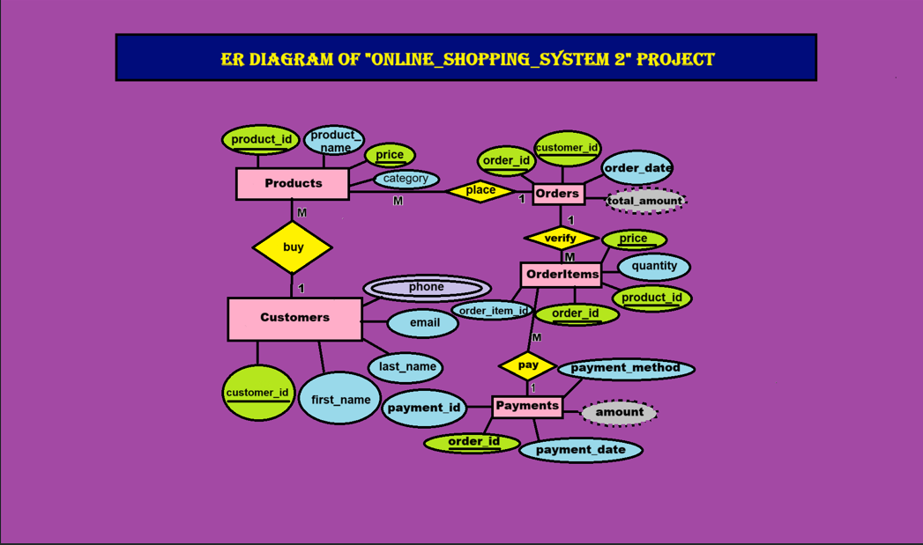
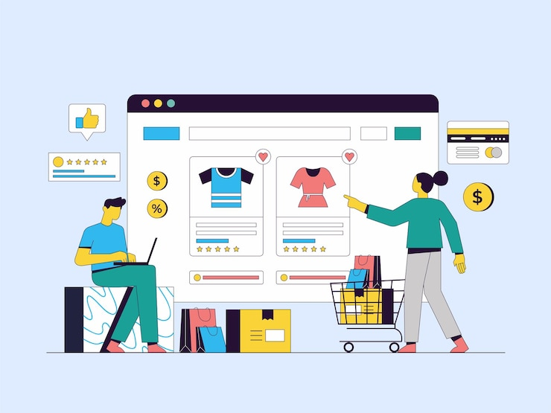

Laboratory Design

Slide 5
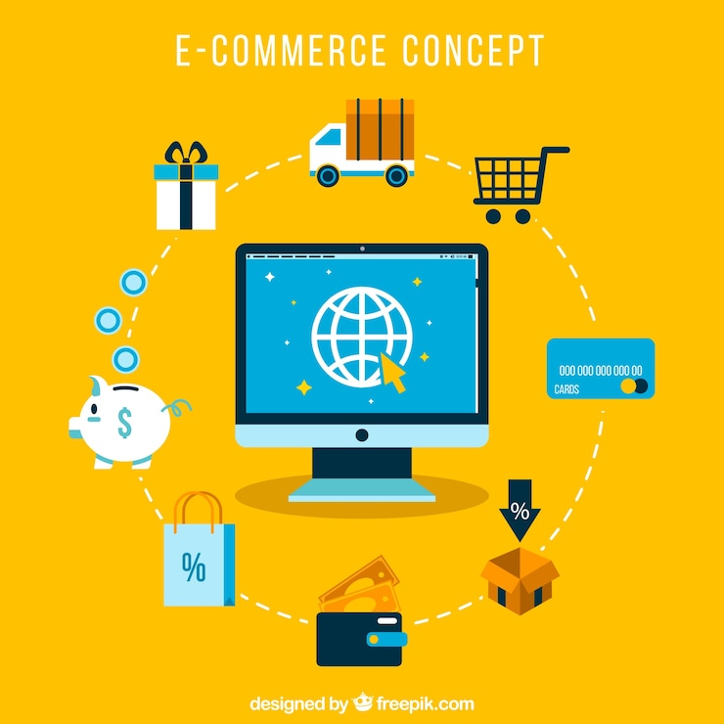



SQL Query :

Slide 6
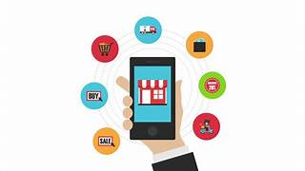

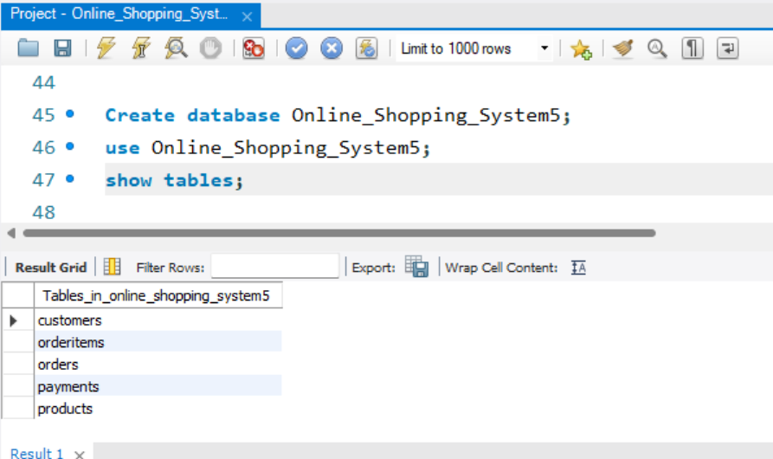
Here are 24 SQL queries that I have use for various operations in an “Online Shopping System”.

Slide 7

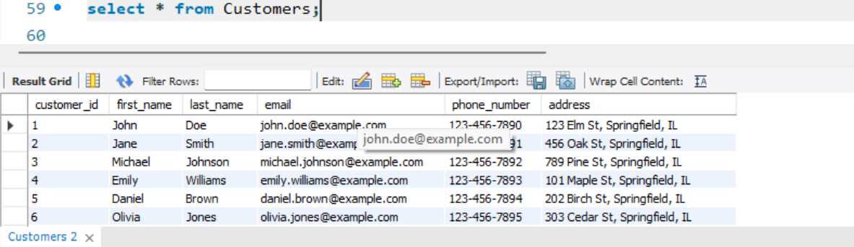
Laboratory Design

Slide 8
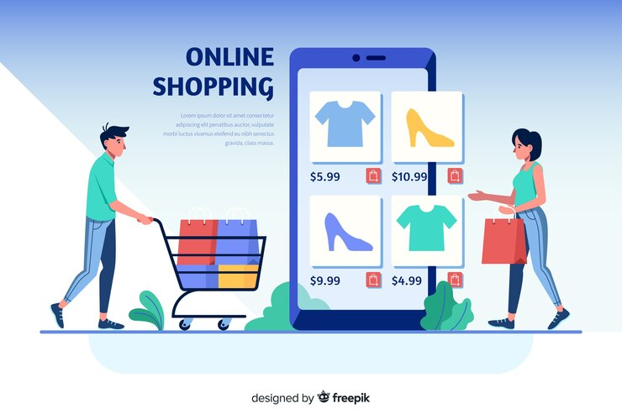
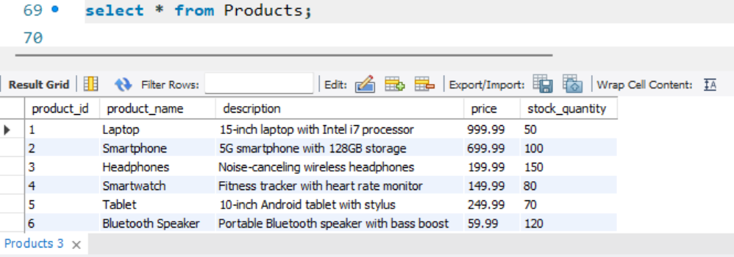
Laboratory Design

Slide 9

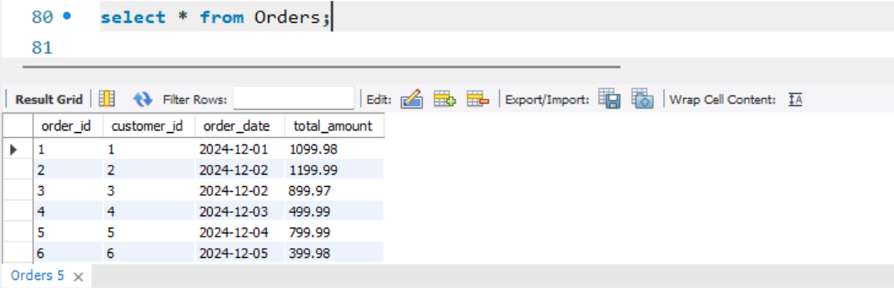
Laboratory Design

Slide 10


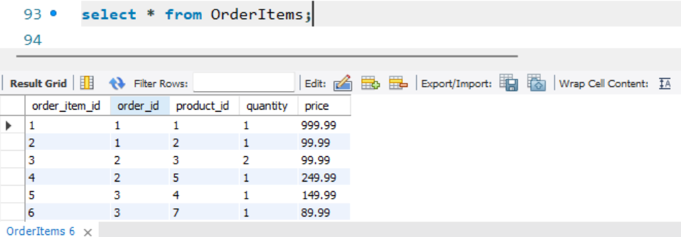
Laboratory Design

Slide 11

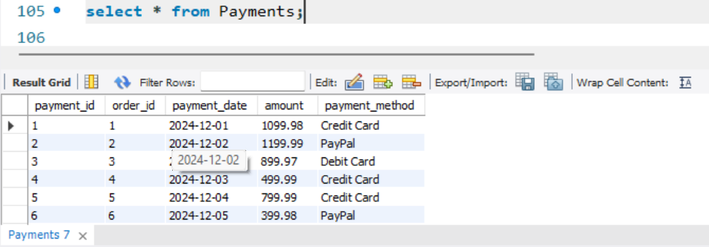
Laboratory Design

Slide 12
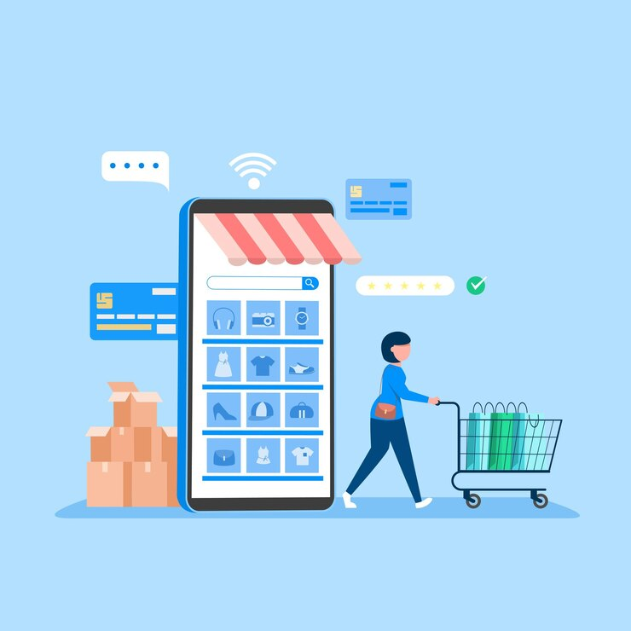
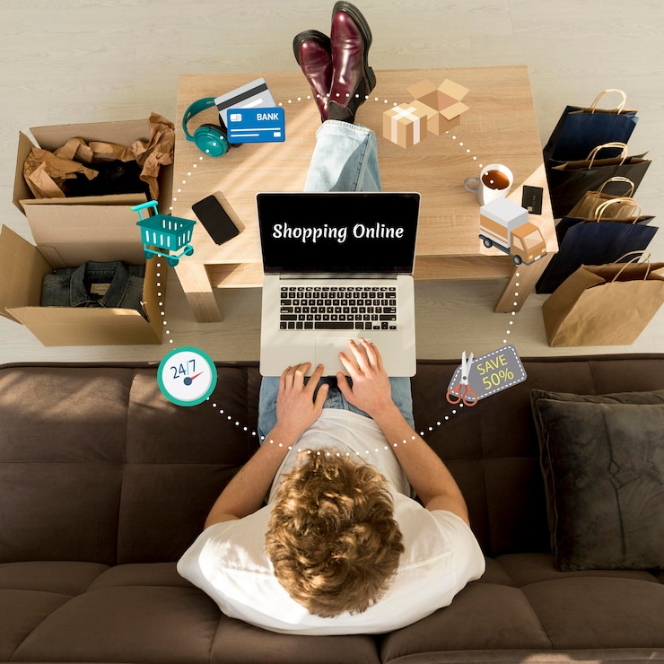
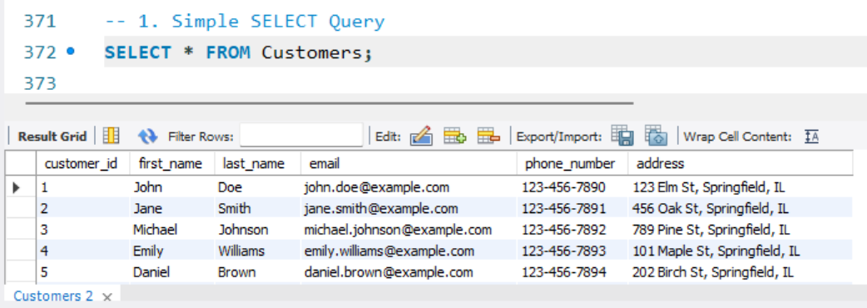
Laboratory Design

Slide 13

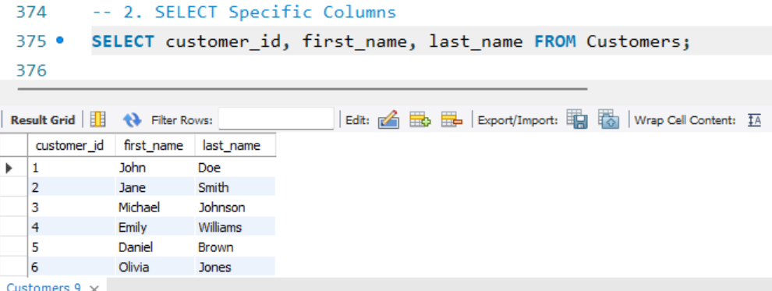
Laboratory Design

Slide 14
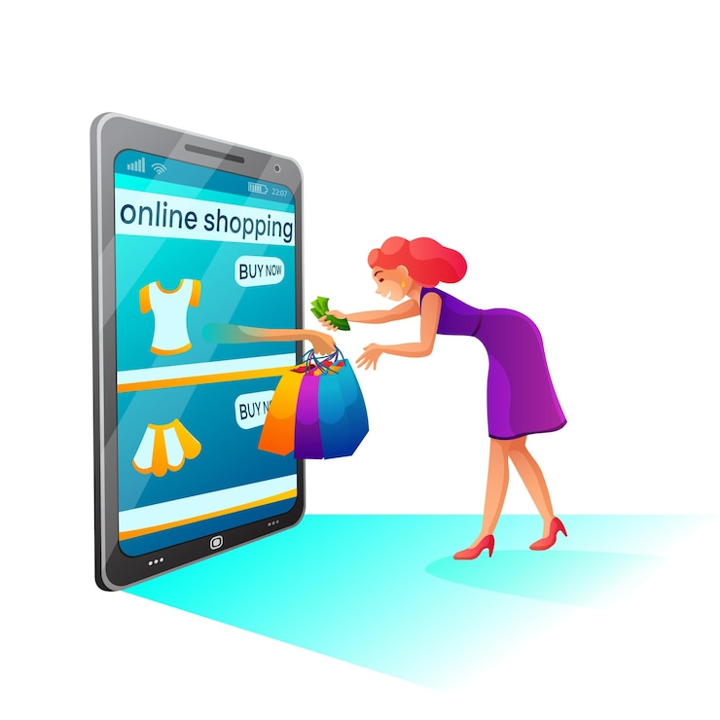

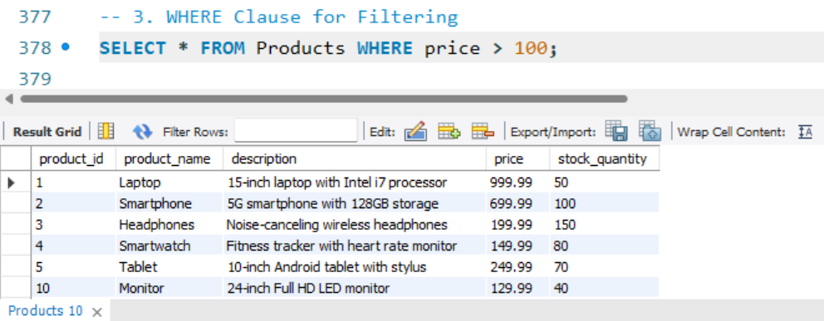
Laboratory Design

Slide 15


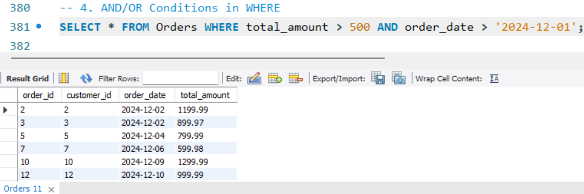
Laboratory Design

Slide 16
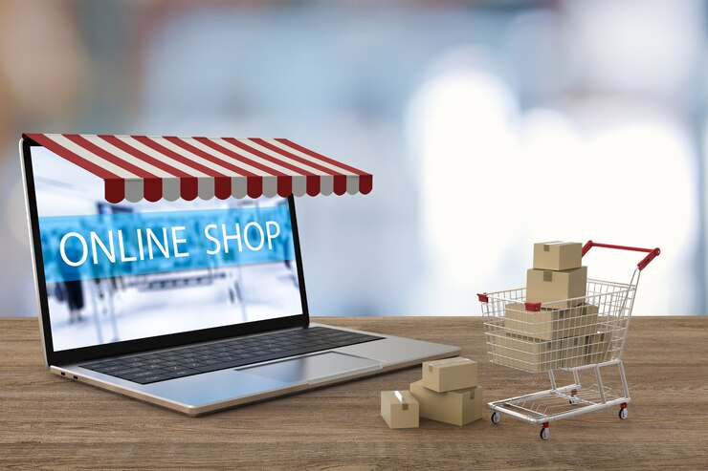
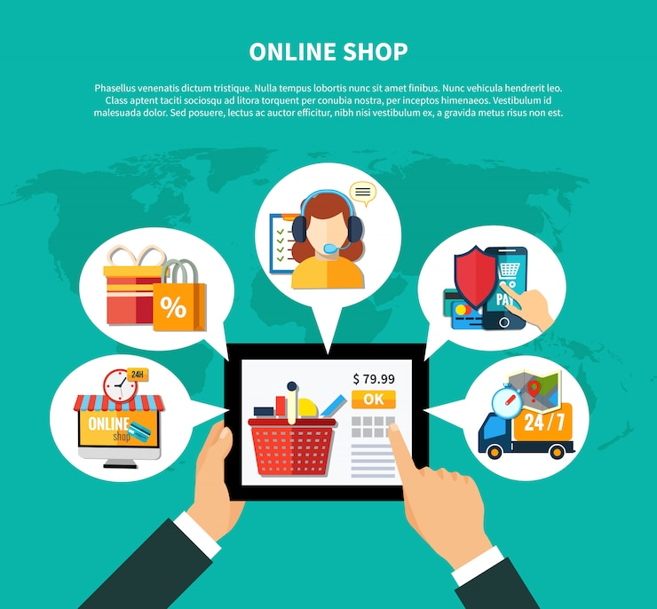
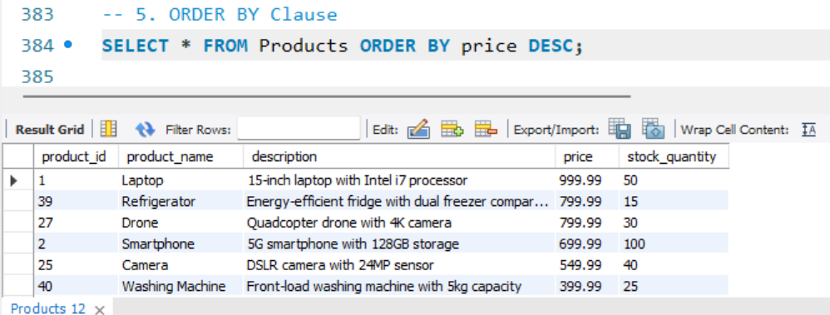
Laboratory Design

Slide 17
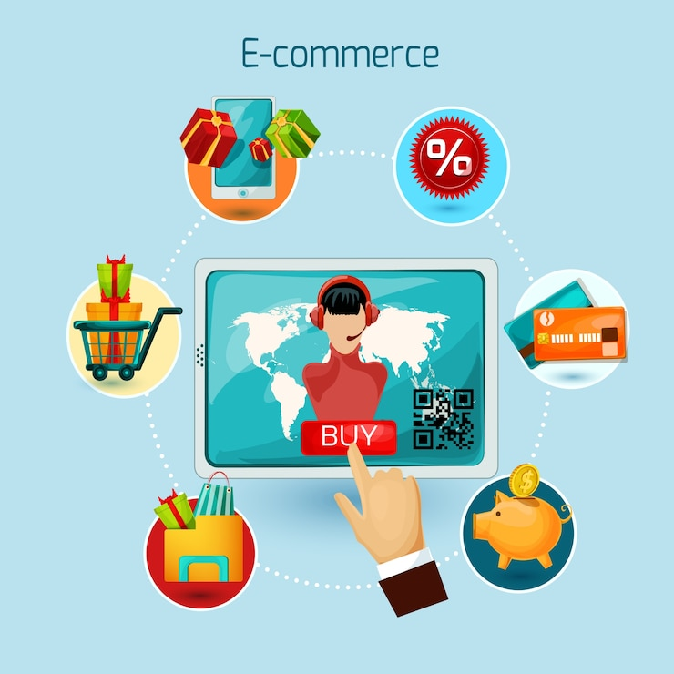

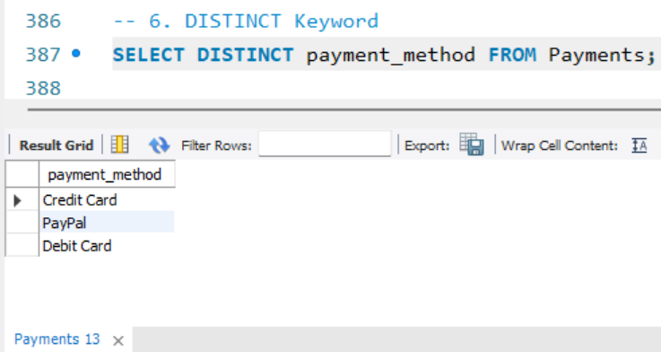
Laboratory Design

Slide 18
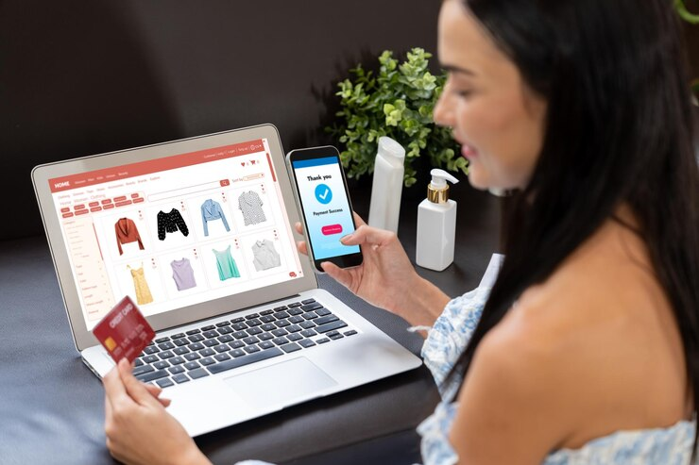

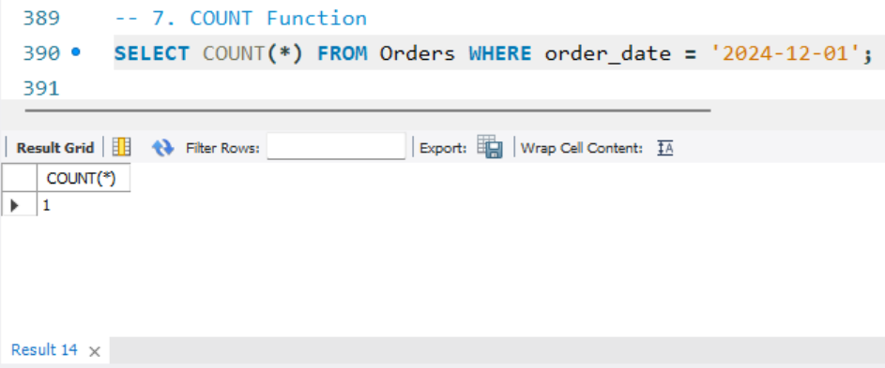
Laboratory Design

Slide 19


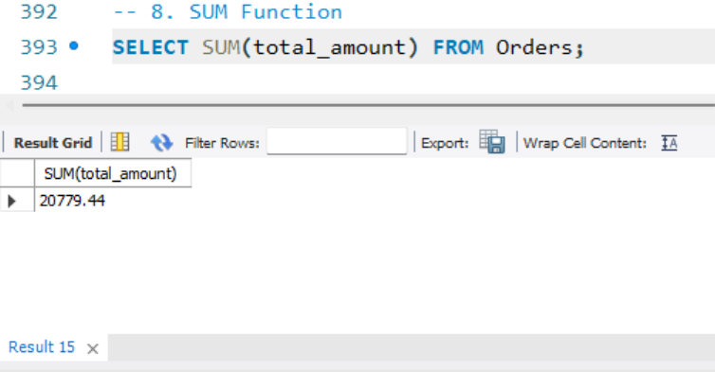
Laboratory Design

Slide 20

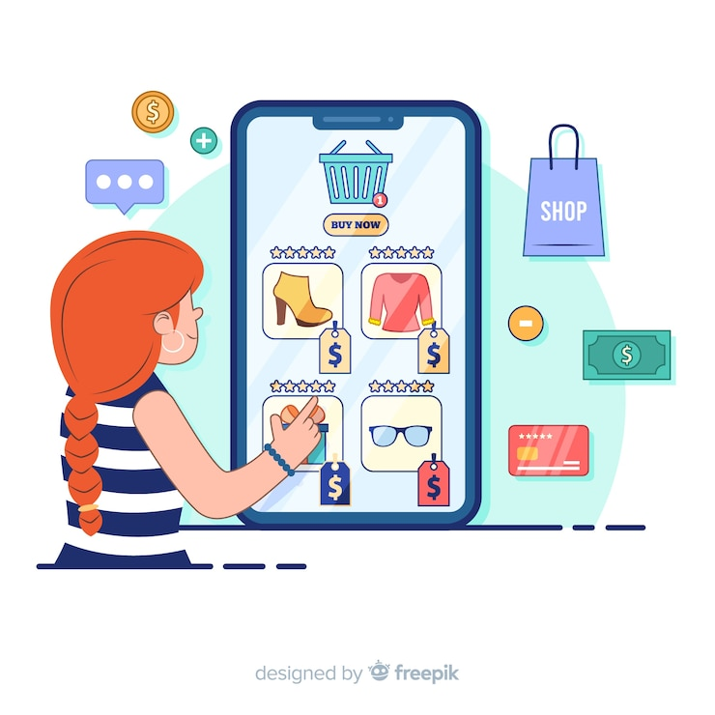
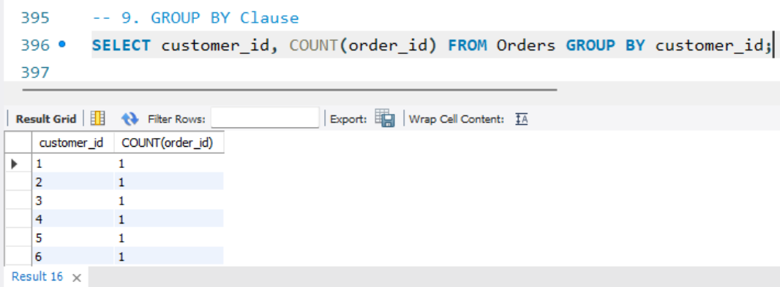
Laboratory Design

Slide 21

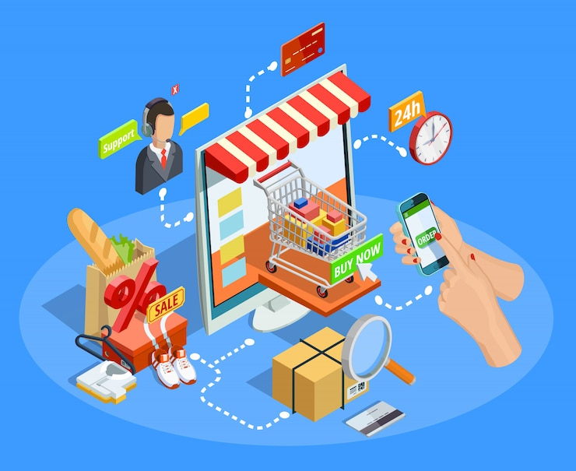
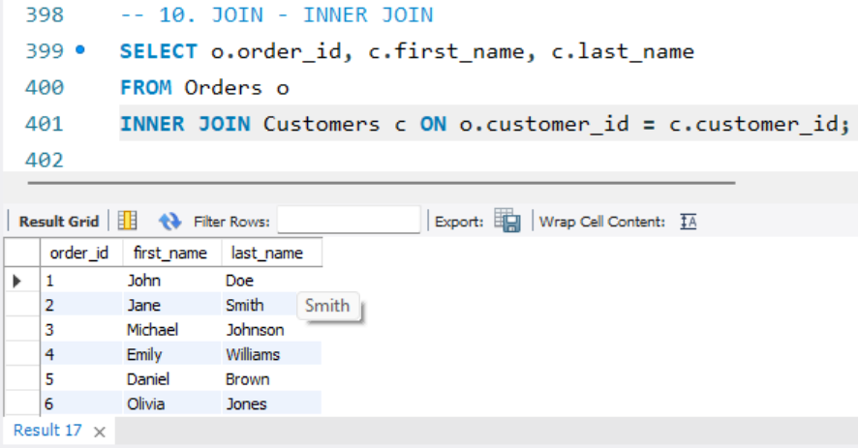
Laboratory Design

Slide 22


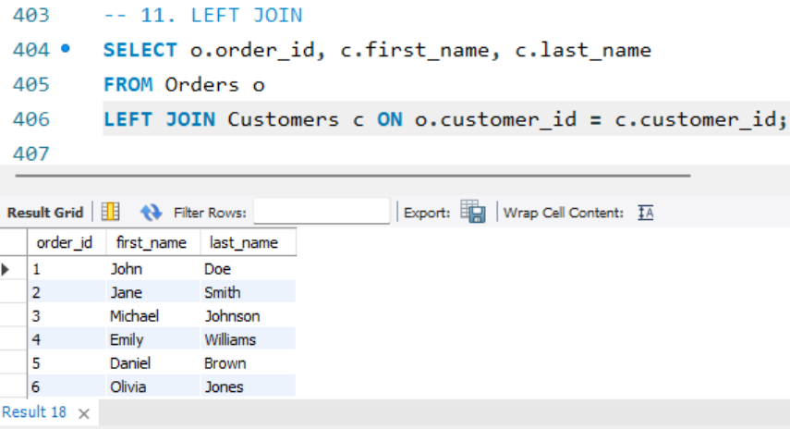
Laboratory Design

Slide 23
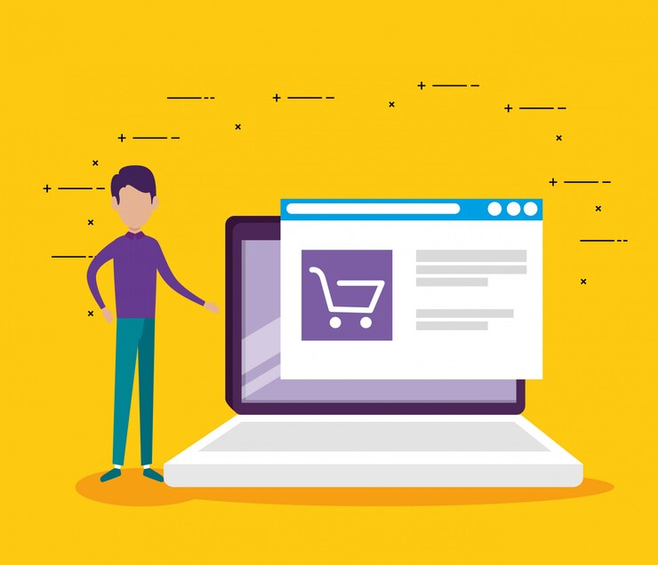

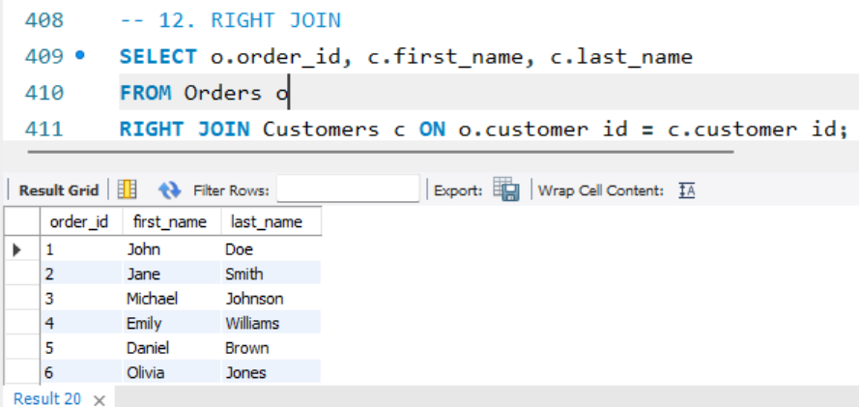
Laboratory Design

Slide 24


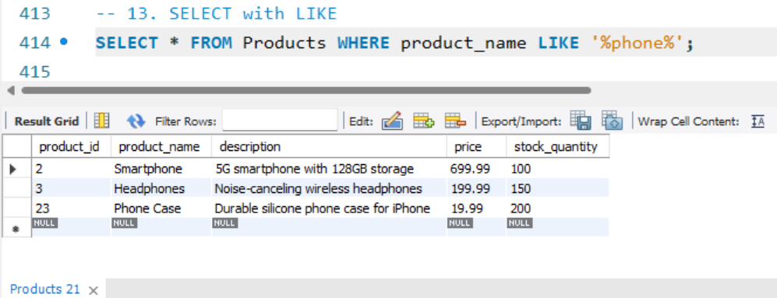
Laboratory Design

Slide 25
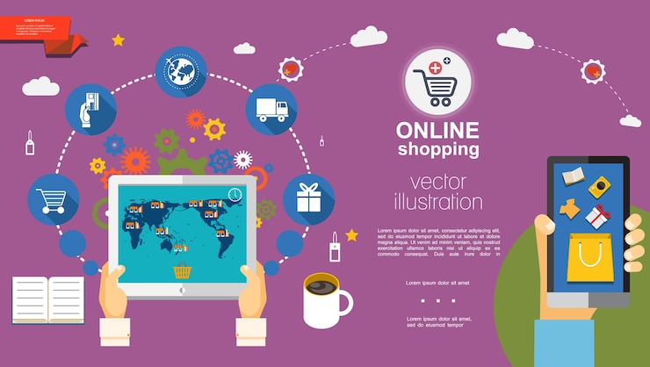
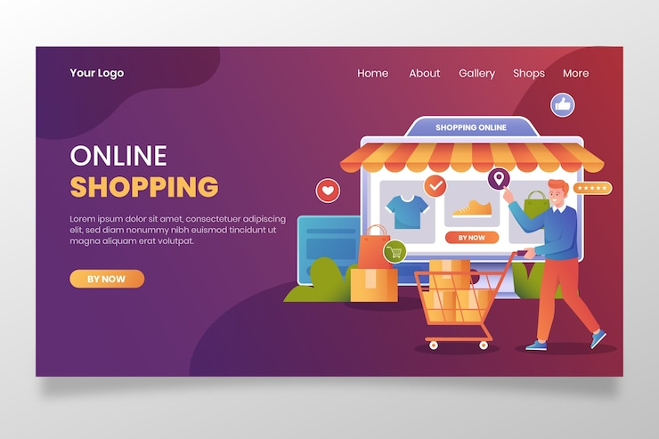
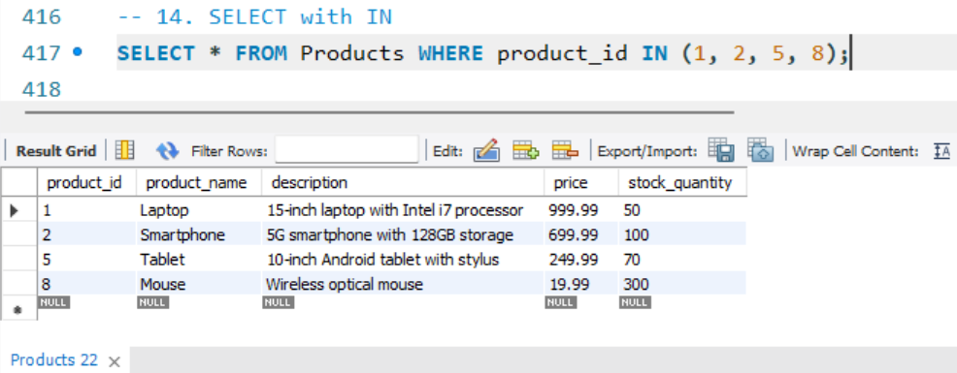
Laboratory Design

Slide 26


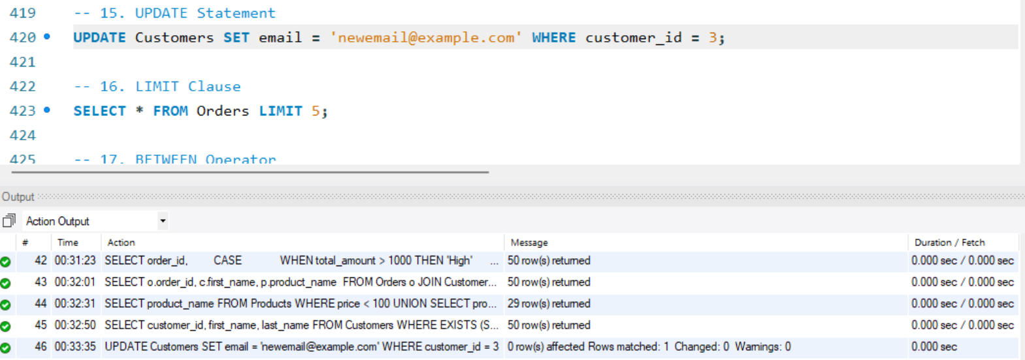
Laboratory Design

Slide 27

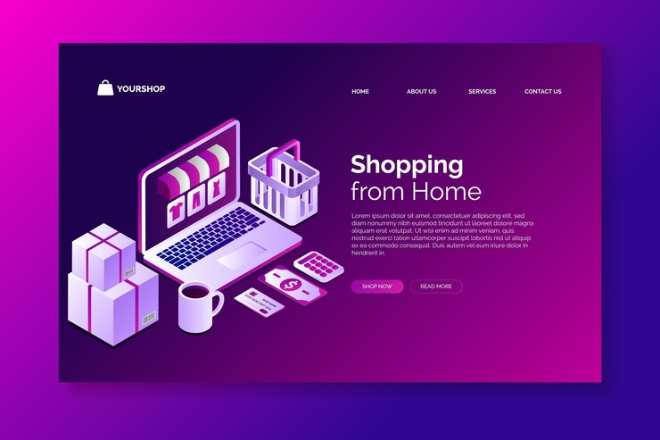
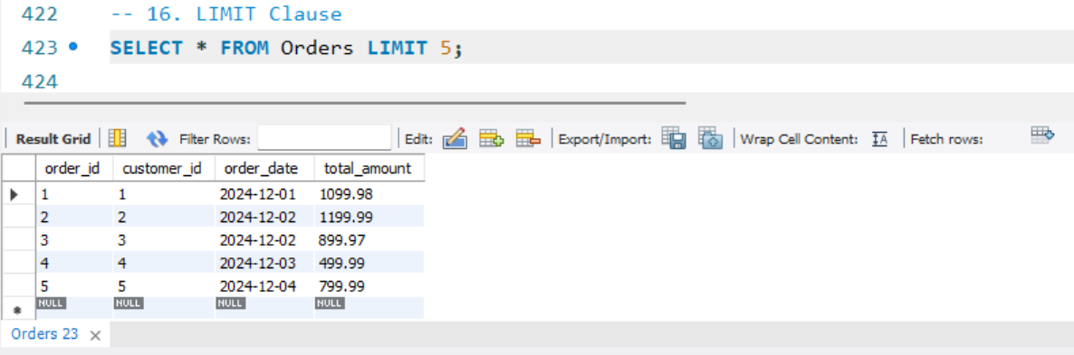
Laboratory Design

Slide 28


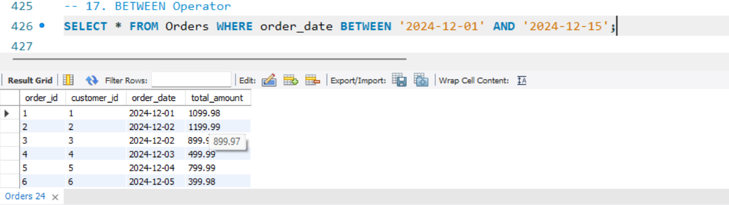
Laboratory Design

Slide 29
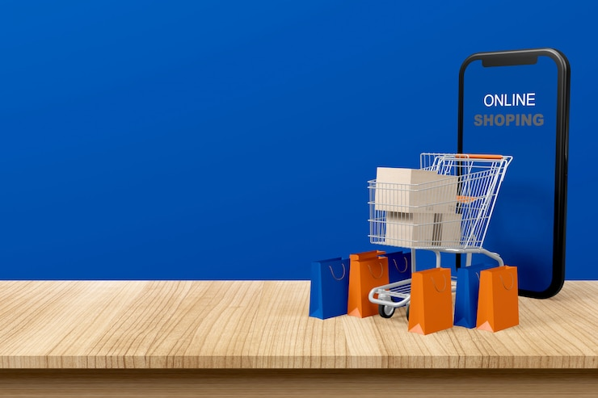

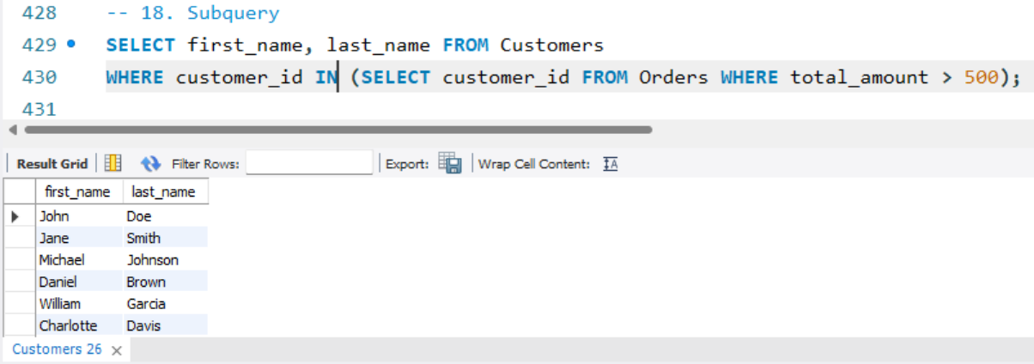
Laboratory Design

Slide 30
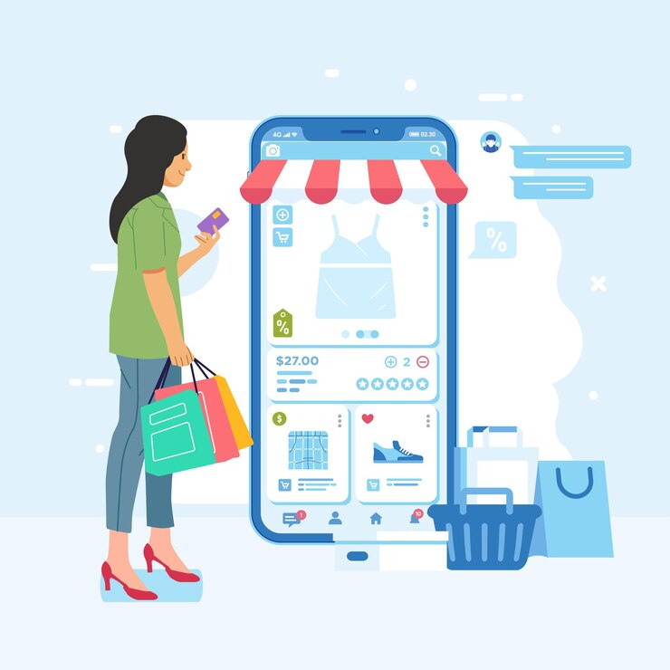

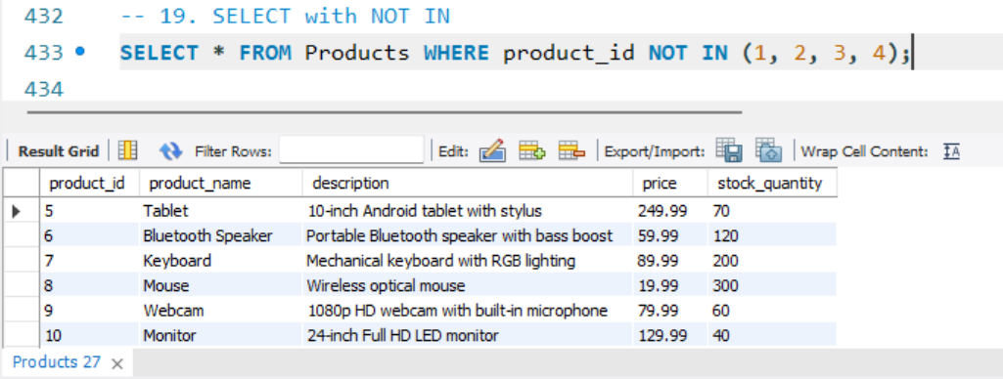
Laboratory Design

Slide 31


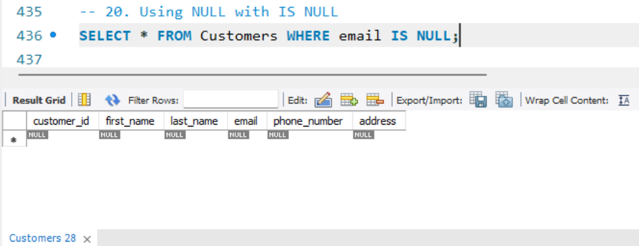
Laboratory Design

Slide 32


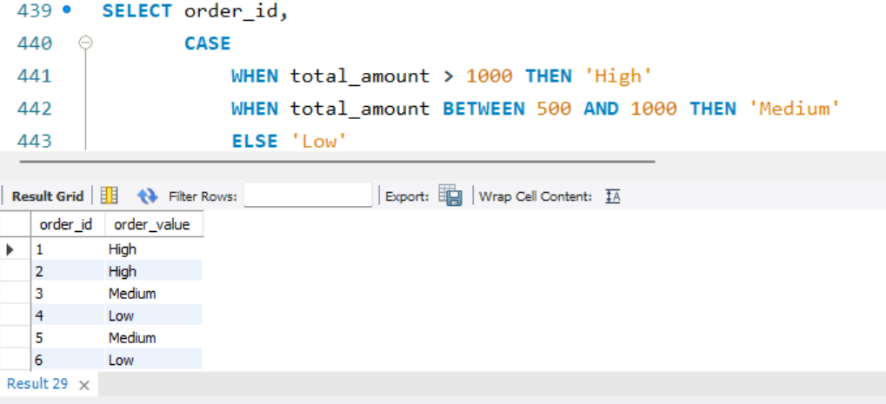
Laboratory Design

Slide 33
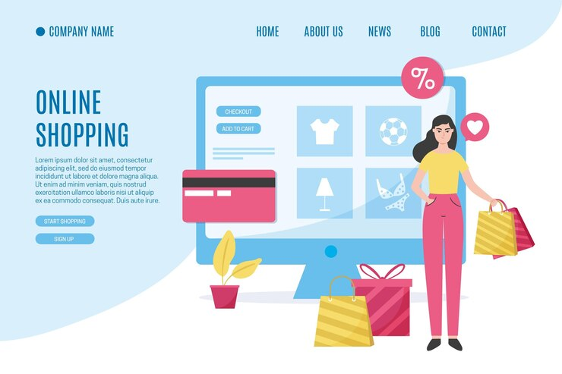

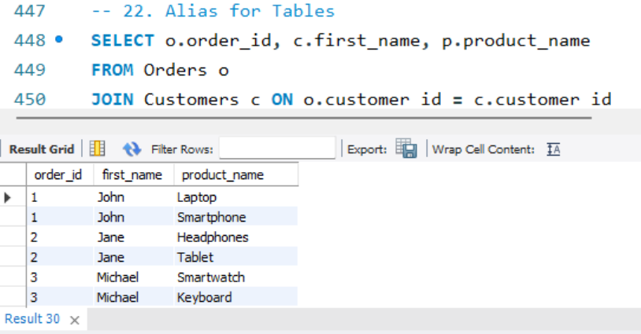
Laboratory Design

Slide 34



Laboratory Design

Slide 35



Laboratory Design

Slide 36



Insights :
💡 Real-World Mapping : Translating real-life e-commerce processes into a relational database helped me understand how business logic is applied in backend systems.
🔄 Entity Relationships : Designing accurate relationships (1:1, 1:M, M:1, M:M) was crucial for maintaining data integrity and enabling accurate reporting.
🛒 Customer Behavior Tracking : Structuring the database to track user orders and product views provided insights into how businesses analyze customer behavior.
⚙️ Query Optimization : Writing complex queries using JOINs, subqueries, and indexing taught me the importance of performance tuning in large databases.
🧾 Data-Driven Decisions : Learned how well-structured databases support critical business functions such as sales tracking, inventory alerts, and customer segmentation.
🧩 Integrated Thinking : The project encouraged thinking beyond just table creation—considering user experience, administrative needs, and backend efficiency.

Slide 37


Future_Scope :
💳 Payment Gateway Integration : Future versions can incorporate real-time payment processing using APIs like Razorpay, Stripe, or PayPal for secure transactions.
📦 Advanced Inventory Management : Implement automated stock alerts, supplier restocking modules, and real-time inventory synchronization.
🧠 Recommendation System : Add machine learning-based product recommendation features using customer behavior and purchase history to improve user engagement.
🔐 User Authentication & Role Management : Enhance security by adding user login systems, admin control panels, and access restrictions based on roles.
📊 Business Analytics Dashboard : Develop dashboards using tools like Power BI or Tableau to visualize sales trends, user demographics, and inventory data.
📱 Multi-Platform Access : Extend system functionality to mobile apps for customers and sellers, improving accessibility and market reach.
📬 Order Tracking and Notification System : Add real-time order tracking and customer notifications through email/SMS.

Slide 38


Conclusion :
The Online Shopping System project successfully demonstrates how a well-structured relational database can support the core functionalities of an e-commerce platform.
By designing and implementing the system in MySQL, this project provided hands-on experience in database modeling and query development.
The system efficiently manages users, products, orders, and transactions, ensuring data integrity and smooth information flow.
Through the creation of ER diagrams, table schemas, and SQL queries, the project enhanced practical understanding of how backend databases power real-world applications.
Overall, this project not only strengthened my technical skills in database design and SQL but also deepened my understanding of how data supports business operations in the digital retail space.
It lays a solid foundation for future development, including advanced analytics, and scalable deployment.

Slide 39




Laboratory Design

